Slide 1
https://www.slideshare.net/databricks/spark-sql-join-improvement-at-facebook

Slide 2
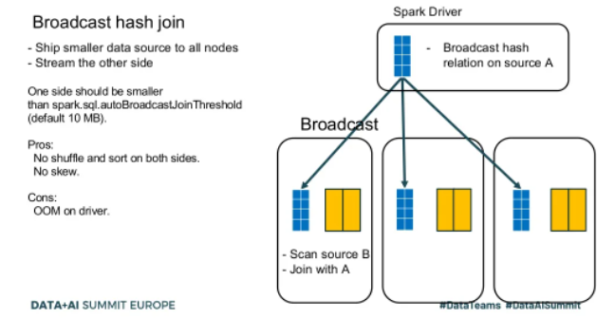

Slide 3
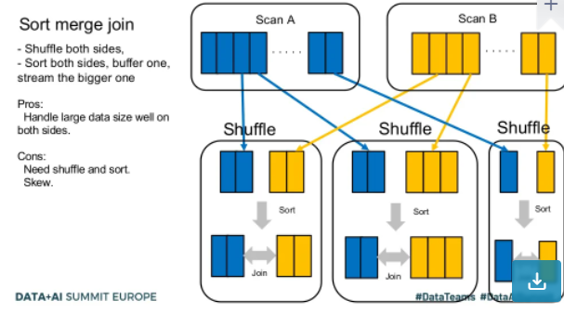

Slide 4
